Slide 1

Sentence Types: Structure
Sentences are Either:
Simple: e.g. Learning English is interesting.
Compound: e.g. Learning English is interesting, but it is never an easy task.
Complex: e.g. I like reading novels when I have spare time.
Complex-compound: e.g. I like reading novels when I have spare time, but I hardly have spare time.

Slide 2
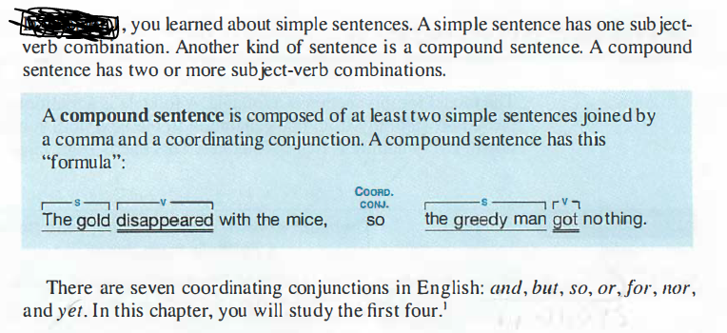

Slide 3
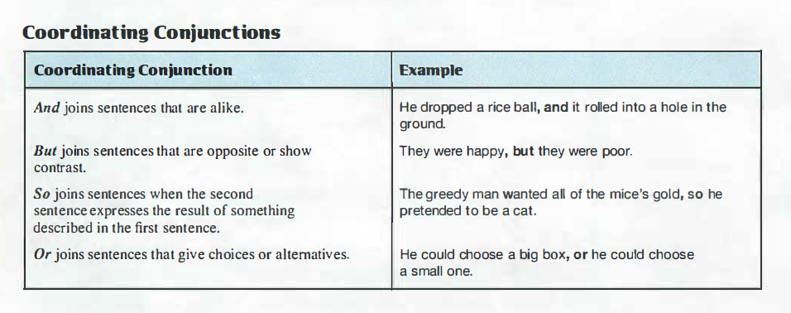

Slide 4
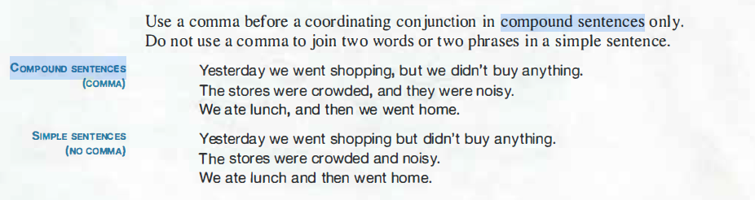

Slide 5
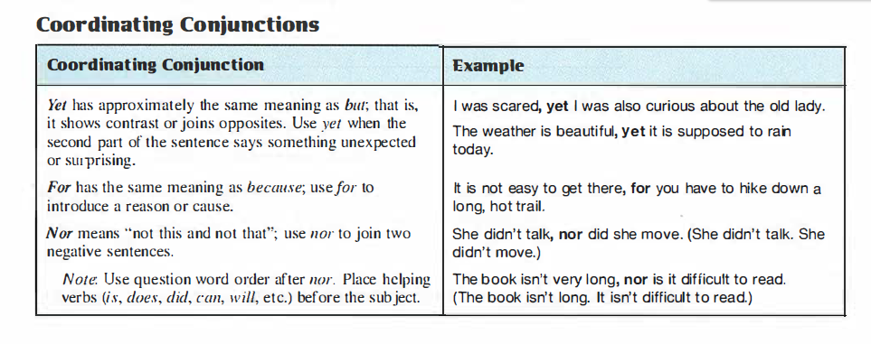

Slide 6
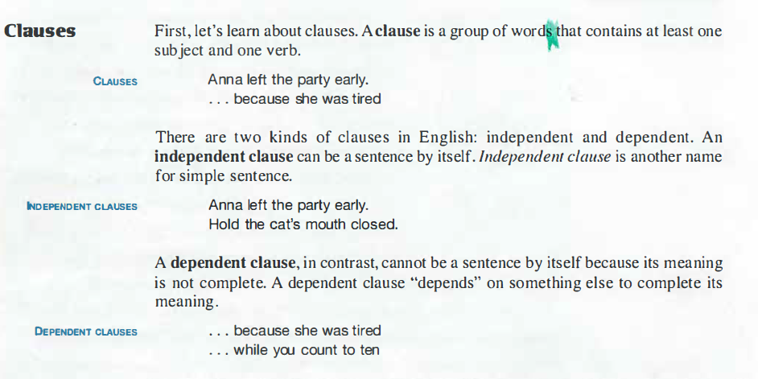

Slide 7
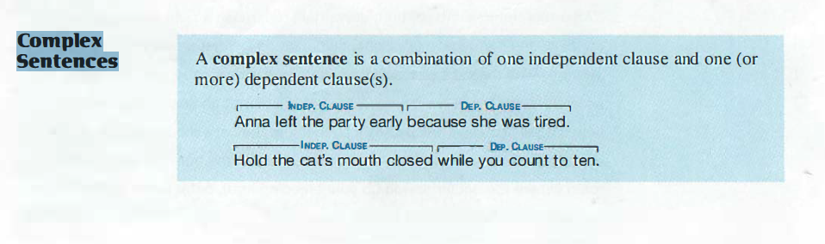

Slide 8
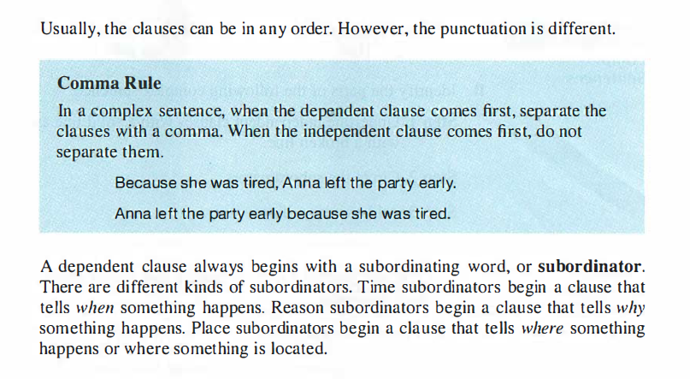

Slide 9
Subordinate Conjunctions
Subordinating conjunctions join independent clauses with a dependent or subordinate clause. A clause that is dependent (subordinate) is a clause that contains two qualities.
The first quality is that is does not have complete a thought on its own; meaning it can’t act as a sentence on its own. The second quality is that it depends on an independent clause, one that can act as a sentence on its own.

Slide 10
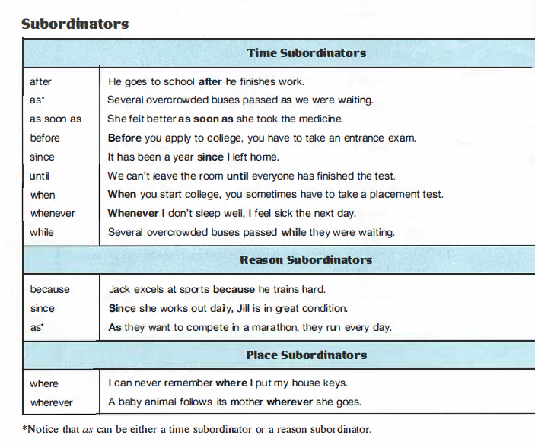

Slide 11
Compound-Complex Sentences:
As the name suggests, a compound-complex sentence brings both of these sentence forms together. That is, it contains at least two independent clauses (like a compound sentence) and at least one dependent clause (like a complex sentence). For example:
Erin loves her brother, and he loves her too because she pays his bills.
The dog ran off when I chased him, but I didn't care.
Though my mother says it doesn't matter, I am tall, and she is short.
Note that the dependent clause can be at the beginning, middle, or end of a compound-complex sentence. No matter where it is placed, the punctuation follows the rules for both compound sentences and complex sentences.
That means that you need to put a comma before the coordinating conjunction and, if applicable, another comma after the dependent clause when it occurs at the beginning of the sentence

Slide 12
See some additional examples to get a feel for how compound-complex sentences will help you add detail to your writing:
When I went to the store, my parents wanted me to pick up some milk, but I didn't have enough money.
Even if the child is hungry, he will never eat oatmeal, but he will always eat ice cream.
The man was mean because he was lonely, but his attitude only made his situation worse.
The dog needed a new leash, and he couldn't go for a walk until he had one.
It is important to vote when the time comes, or you won't get a say in new laws.
Writing compound-complex sentences allows you a great deal of flexibility to explain how, why or when something happened. It's important to understand which parts of the sentence are independent clauses and which are dependent clauses so that you can punctuate it correctly and avoid writing a run-on sentence. Once you master this, you can freely add them to your writing to express more complicated ideas with clarity.

Slide 13
By the way, this lecture has been prepared in collaboration with
Mrs. Rasha
Many thanks to her

